Slide 1
EVENT HANDLING
Sit Dolor Amet

Slide 2
EVENT DRIVEN PROGRAMMING
Event-driven programming is a programming style that uses a signal-and-response approach to programming
An event is an object that acts as a signal to another object know as a listener
The sending of an event is called firing the event
The object that fires the event is often a GUI component, such as a button that has been clicked

Slide 3
LISTENERS
A listener object performs some action in response to the event
A given component may have any number of listeners
Each listener may respond to a different kind of event, or multiple listeners might may respond to the same events

Slide 4
EVENT HANDLERS
A listener object has methods that specify what will happen when events of various kinds are received by it
These methods are called event handlers
The programmer using the listener object will define or redefine these event-handler methods

Slide 5
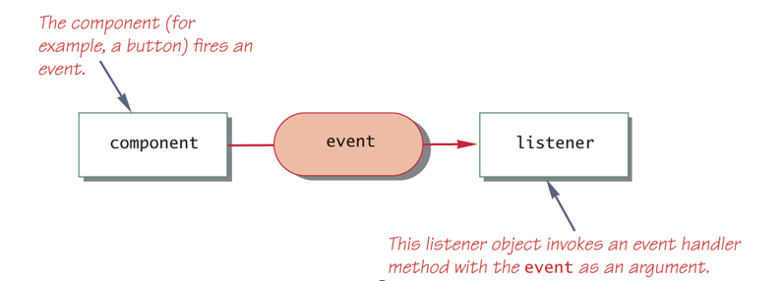
EVENT FIRING AND EVENT LISTENER

Slide 8
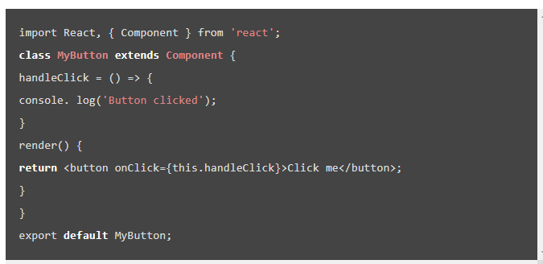

Slide 9
EXAMPLE
Add a component known as FunctionClick.js and edit it as follows:

Slide 10
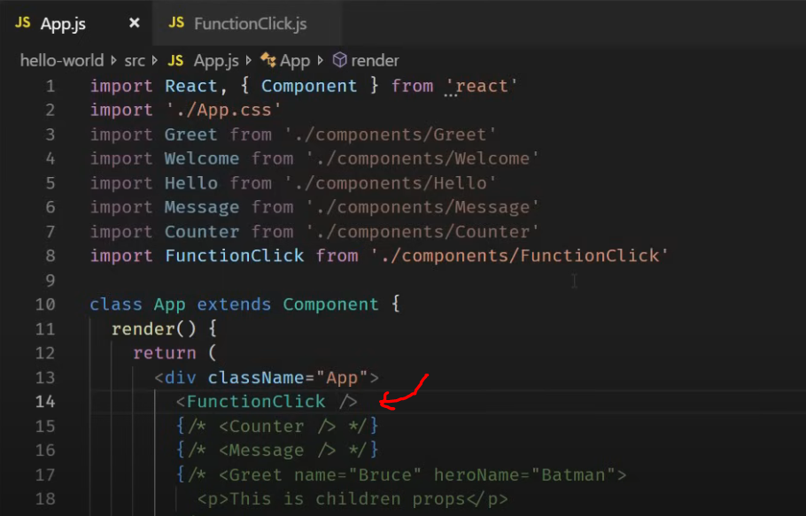
Make reference to the added component from the App.js root component. Save and see the output on the console.

Slide 11
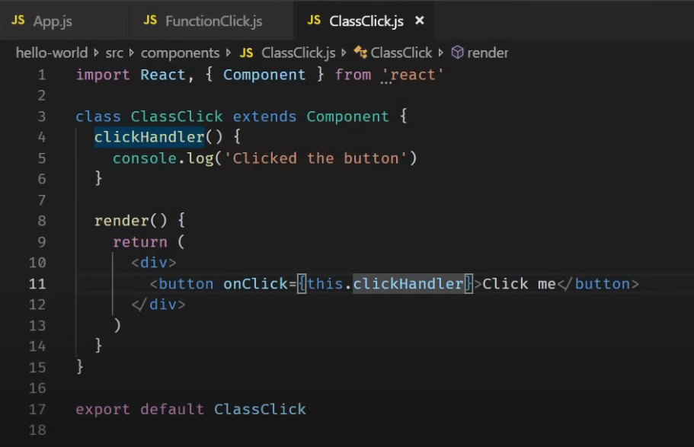
Similar approach is taking with class components with the only difference being that objects are made use of.
To do this add a class component (ClassClick.js) as shown below:

Slide 12
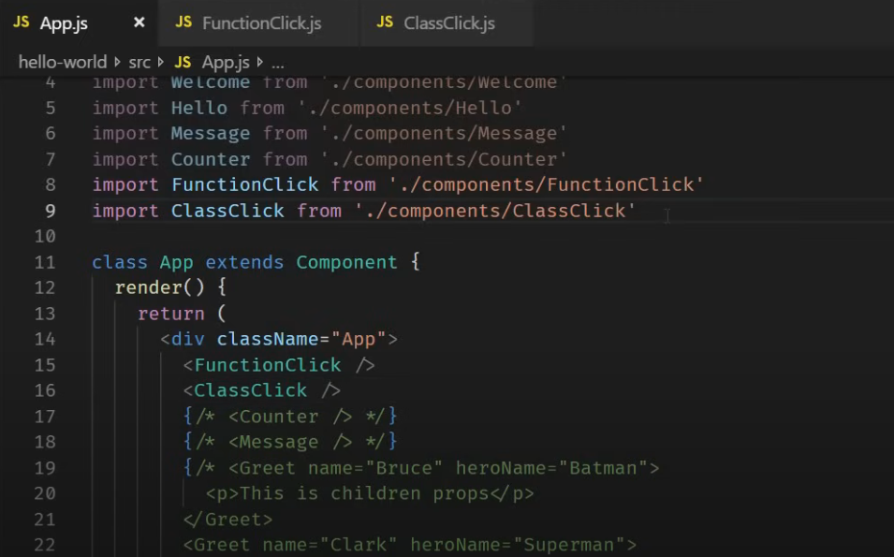
Make reference to the added component from the App.js root component. Save and see the output on the console.

Slide 13
BINDING OF EVENT HANDLERS
Binding of event handlers eliminates the problem of returning undefined values when an event handler is executed. There are four different ways of doing binding of event handlers in React JS:
Binding event handler in the Render Method
Binding Event Handler Using an arrow function
Binding Evet Handlers in the Constructor
Binding Event handlers Using Arrow Function as a class property.

Slide 14
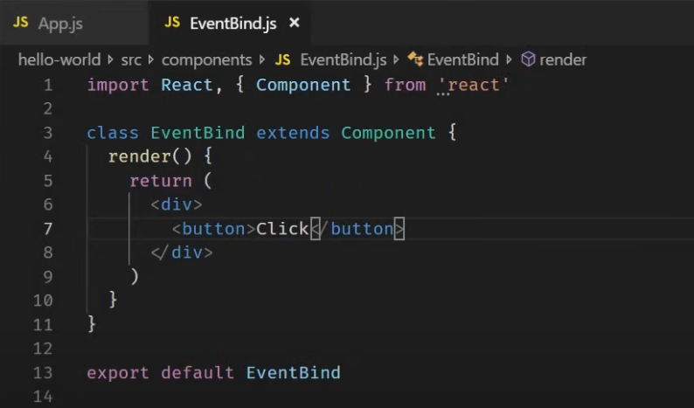
EXAMPLE
Create a new file called EventBind.js and create a class component in it a shown below.

Slide 15
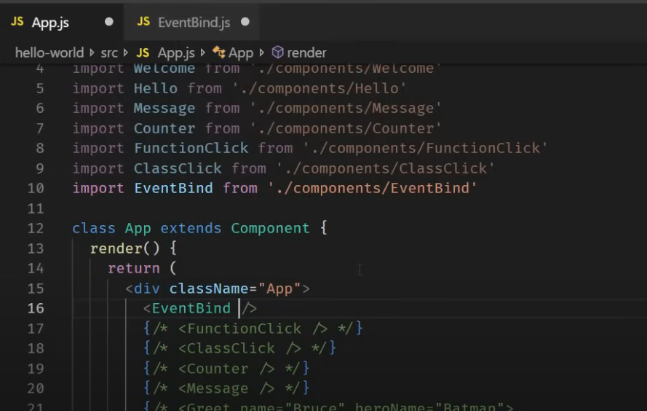
EXAMPLE
Include the created component into the App.js component.

Slide 16
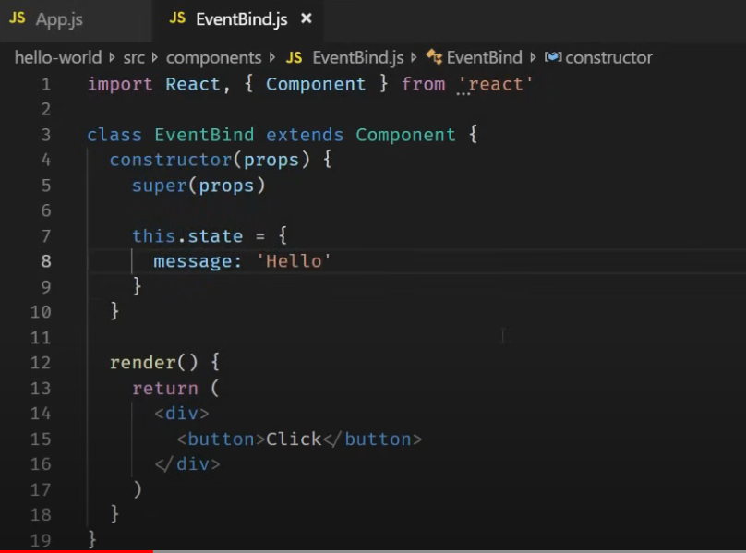
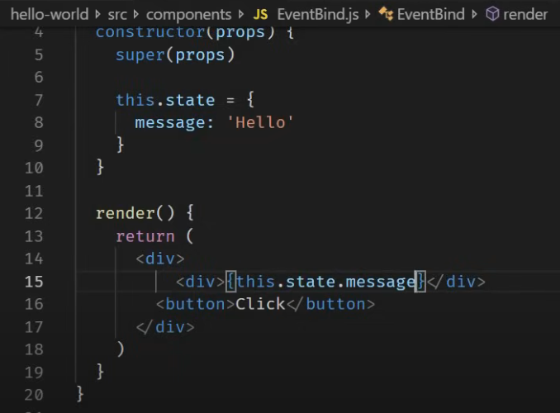
EXAMPLE
Create a state property called message in the EventBind.js and bind it with the interface. Also add the rendering state (on the right). Save and see output on the browser.

Slide 17
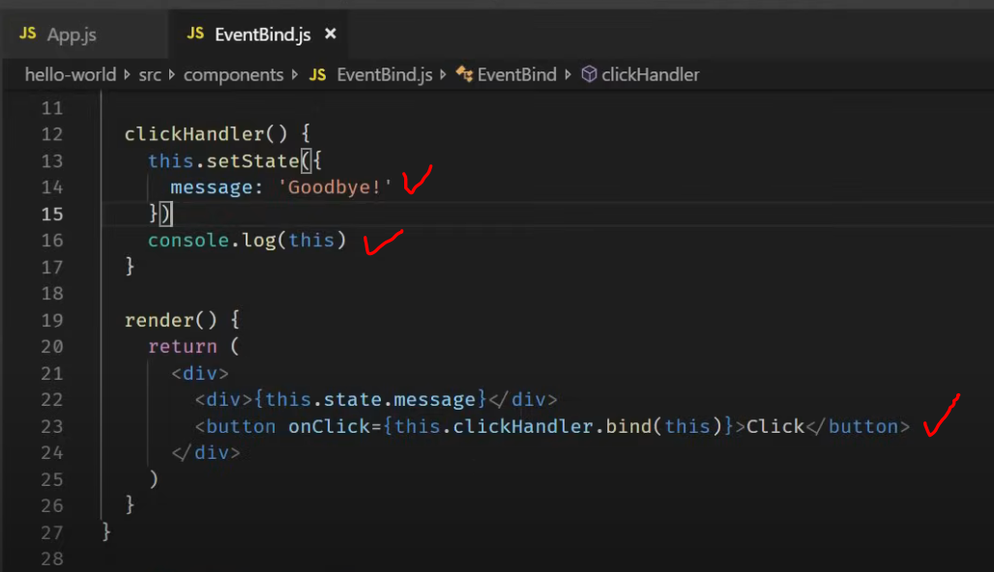
EXAMPLE
To change the message to “Good Bye” when the user clicks the button, binding can be done in four different ways.
The first is to bind the state with the event handler (see below). Edit the file, then save and run.

Slide 18
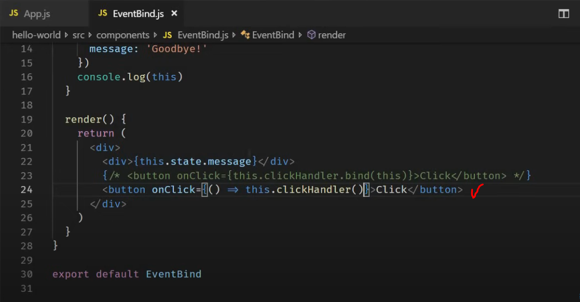
EXAMPLE
The second is to use arrow functions in the render method. Edit the file, save then view the output.

Slide 19
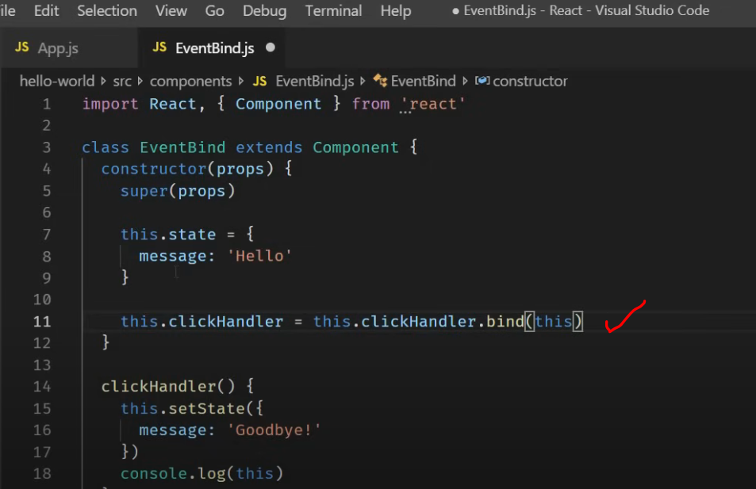
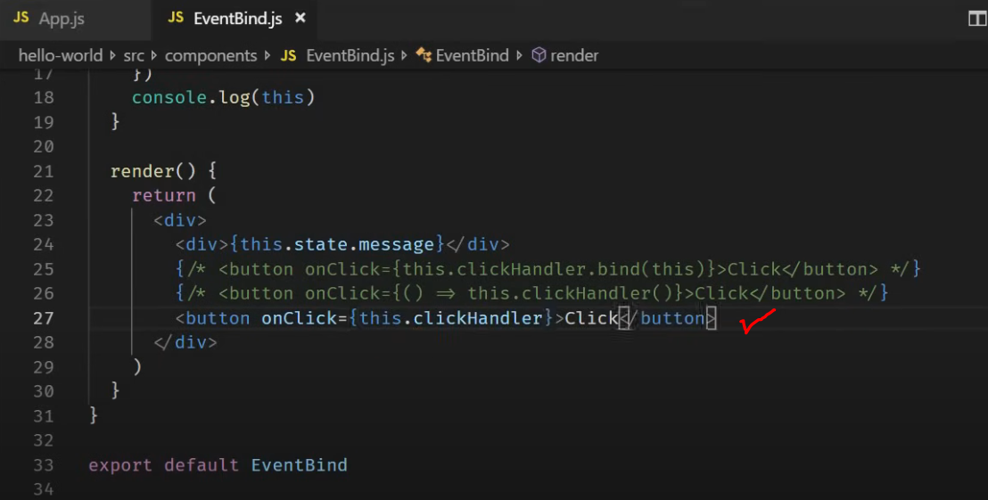
EXAMPLE
The third approach is to include the event handler in the constructor of the class (most popular approach)
Notice the definition within the constructor 9left) and the reference to the event handler in the render method (right)

Slide 20
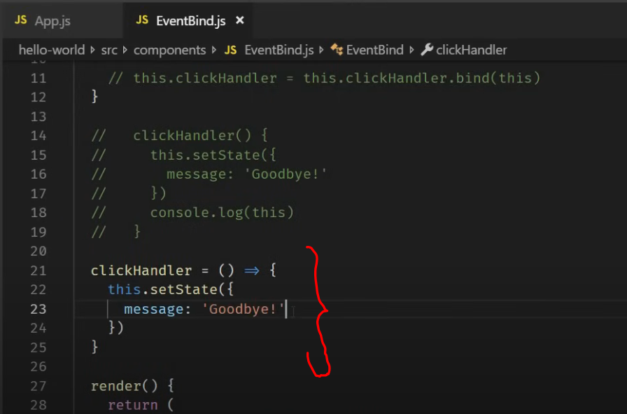
EXAMPLE
The fourth approach is to use the arrow function as a class property. Edit the file, save then view the output.

Slide 21
END

