Slide 1
Logical Operators
Session -03

Slide 2
Table of contents
What are Logical Operators
AND, OR, and NOT Operators
Relational Operators
Precedence of Operators
Creating programs to demonstrate the use of operators on Quarky.
Creating a program that takes all the side lengths of the triangle and reports whether a triangle can be made with the side lengths or not.

Slide 3
AND, OR & NOT Operators
Logical operators are fundamental blocks that can be used to build a decision-making capability in your code
When we need to make our decision based on two or more checks, it is necessary to have a combination of logical operators.

Slide 4
1. AND Operator
The AND operator is used to see if two or more conditions are true
If all the conditions are true, the AND operator returns TRUE. If any one of the conditions fail, the AND operator returns FALSE
In python AND operator is denoted by and keyword. Some other programming languages use “&&” as an AND operator

Slide 5
2. OR Operator
The OR operator is used to see if either one of two or more conditions is TRUE.
If any of the conditions is true, the OR operator returns TRUE. If all the conditions fail, the OR operator simply returns FALSE.
In python syntax OR operator is denoted by or keyword. Some other programming languages use “||” as an OR operator.

Slide 6
3. NOT Operator
We use the NOT operator to reverse or negate a condition.
If the condition is true, NOT will return false and vice versa.
In python programming, we use no keyword to denote not operator. Some other programming languages use “!” as NOT operator.

Slide 7
Let’s Connect
Let’s test these statements from a PictoBlox program on Quarky:
Open the PictoBlox Code: https://pictoblox.page.link/quYk1RqjJdcXDMfa8
Connect Quarky
The project has 3 scripts. Test one by one:
And Logic: Press Button A
OR Logic: Press Button B
NOT Logic: Press Button C

Slide 8
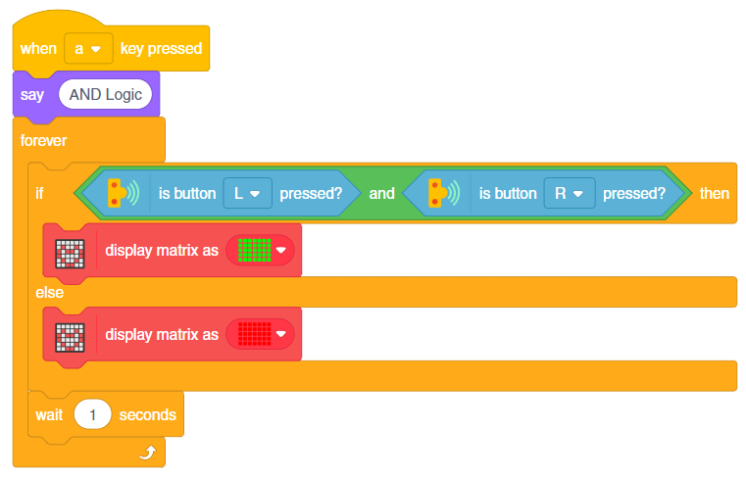
1. And Logic: Press Button A
Quarky has 2 buttons L and R
According to the script, if both L and R are pressed, Quarky will glow with Green Light
Otherwise, it will glow with Red Light.

Slide 9
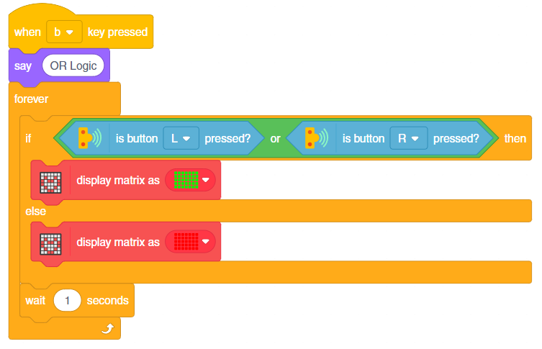
2. OR Logic: Press Button B
Stop all scripts and press keyboard button B.
According to the script, if any of the L and R is pressed, Quarky will glow with Green Light. Otherwise, it will glow with Red Light.

Slide 10
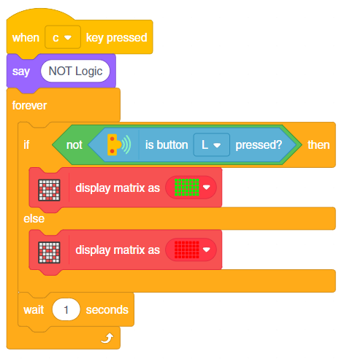
3. NOT Logic: Press Button C
Stop all scripts and press keyboard button C
According to the script, Quarky will glow with Red Light if L is pressed
Otherwise, it will glow with Green Light

Slide 11
Relational Operators
A relational operator is an operator that tests a relation between two entities. The result of a relational operator is either true or false

Slide 12
Operators in PictoBlox
There are 3 types of operators in PictoBlox :
Greater Than | >
Less Than | <
Equals to | =

Slide 13
1. Greater Than >
This block reports true only if the first number is greater than the second number
If the first number is equal to or less than the second, it results in false
Example:
15 > 10 will return True.
10 > 15 will return False.

Slide 14
2. Less Than <
This block reports true only if the first number is less than the second number
If the first number is equal to or greater than the second, it results in false
Example:
15 > 10 will return false.
10 > 15 will return true.

Slide 15
3. Equals to =
It results in true only if the first number is equal to the second number; otherwise, it results in false.

Slide 16
Activity: Can you create a triangle?

Slide 17
Example
The triangle with sides A, B, and C. We know the sum of two sides must be greater than the remaining side:
A + B > C
B + C > A
C + A > B
Unless all sides are compared, we cannot say values for A, B and C are valid or not.
Therefore, we need to combine all three logical expressions to say whether they can truly make a triangle
Let’s implement this in PictoBlox.

Slide 18
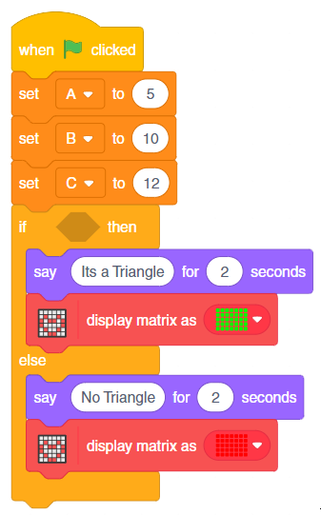
Coding
We have created an incomplete script already for you
Open this project in PictoBlox
https://pictoblox.page.link/PEdJwMCXhHQzFcvT6
We need to add the conditions

Slide 19
Steps
Step-1: Replicate the three conditions first:
A + B > C
B + C > A
C + A > B

Slide 20
Continue…
Step-2: We have to test 3 conditions, so we have to add two () and () blocks together.
Step-3: And Add the three conditions together.

Slide 21
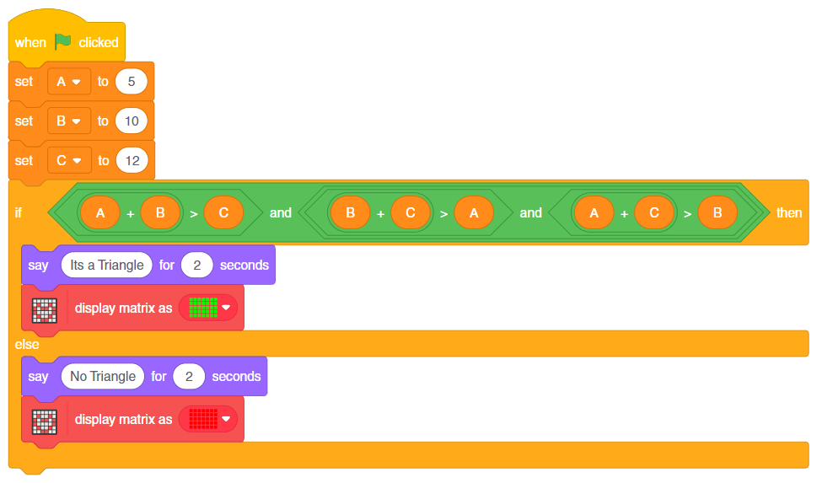
Continue…
Step-4: Add the condition to the if () block.

Slide 22
Precedence
Like arithmetic operators, logical operators also have precedence that determines how the operations are grouped without parentheses
Parentheses can be used to group the operands with their correct operator, just like how we do it in arithmetic
Have a look at the below table to check the precedence of logical operators:
NOT (!) – High
AND (&&) – Medium
OR (||) – Low

Slide 23
Examples
In the below example, A1, A2, A3, and A4 stand for the relational expressions. They have a mix of “&&”, “||” and “!” operators.
A1 && A2 && A3 || A4 can be interpreted as ((A1 && A2) && A3) || A4
A1 || A2 && A3 can be interpreted as A1 || (A2 && A3)
! A1 && A2 || A3 can be interpreted as ((!A1) && A2) || A3
A1 && A2 || A3 && A4 can be interpreted as (A1 && A2) || (A3 && A4)
It is a common practice to use parenthesis to group operands together rather than relying on logical operator precedence rules.

