Slide 1
Tobi Controlled with Button
Session 15

Slide 2
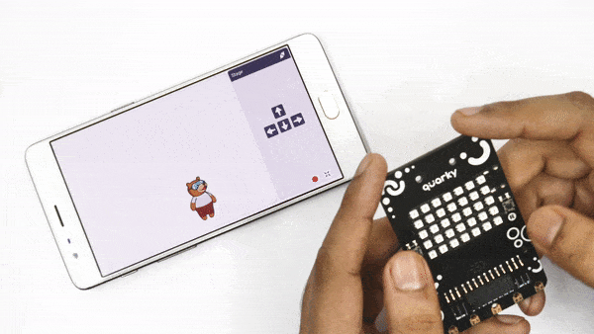
Tobi Control
Before we start making our game, we need to understand one very important part of the game – controlling Tobi’s movements. We’re going to do it using Quarky’s buttons.

Slide 3
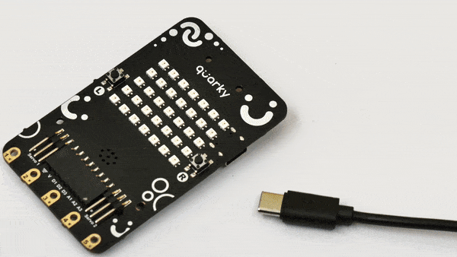
Connecting the Quarky
Follow the below steps to connect Quarky.
Open PictoBlox on your desktop.
Connect your Quarky.
Quarky can be connected via USB or the Bluetooth Port if you want to connect Quarky via Bluetooth and press Connect.
STEP 1
STEP 2

Slide 4
Let’s Code
Drag the below blocks into the scripting area.
is button () pressed – Sensors
If – Control
move () steps – Motion
If L is pressed, then, according to our logic, Tobi should move left. Write -10 in the space. The “-” sign means that direction of movement is left.

Slide 5
Let’s Code
Drag the below blocks into the scripting area.
if – Control
move () steps – Motion
forever – Control
when flag clicked – Events
This time press R, then, according to our logic, Tobi should move right. Write 10 in the space. The “+” sign means that direction of movement is right.
Save the project file as Tobi Control.

